Slide 1

Slides for Chapter 8:
Distributed Objects and Components
From Coulouris, Dollimore, Kindberg and Blair
Distributed Systems:
Concepts and Design
Edition 5, © Addison-Wesley 2012

Slide 2
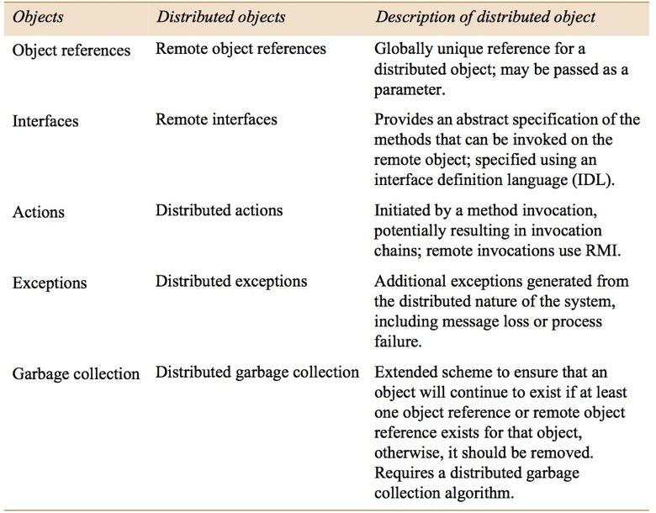
Figure 8.1
Distributed objects
Instructor’s Guide for Coulouris, Dollimore, Kindberg and Blair, Distributed Systems: Concepts and Design Edn. 5
© Pearson Education 2012

Slide 3
Figure 8.2
IDL interfaces Shape and ShapeList
struct Rectangle{ 1
long width;
long height;
long x;
long y;
} ;
struct GraphicalObject { 2
string type;
Rectangle enclosing;
boolean isFilled;
};
interface Shape { 3
long getVersion() ;
GraphicalObject getAllState() ; // returns state of the GraphicalObject
};
typedef sequence <Shape, 100> All; 4
interface ShapeList { 5
exception FullException{ }; 6
Shape newShape(in GraphicalObject g) raises (FullException); 7
All allShapes(); // returns sequence of remote object references 8
long getVersion() ;
};
Instructor’s Guide for Coulouris, Dollimore, Kindberg and Blair, Distributed Systems: Concepts and Design Edn. 5
© Pearson Education 2012

Slide 4
Figure 8.3
IDL module Whiteboard
module Whiteboard {
struct Rectangle{
...} ;
struct GraphicalObject {
...};
interface Shape {
...};
typedef sequence <Shape, 100> All;
interface ShapeList {
...};
};
Instructor’s Guide for Coulouris, Dollimore, Kindberg and Blair, Distributed Systems: Concepts and Design Edn. 5
© Pearson Education 2012

Slide 5
Figure 8.4
IDL constructed types – 1
Type
Examples
Use
sequence
typedef sequence <Shape, 100> All;
Defines a type for a variable-length
typedef sequence <Shape> All
sequence of elements of a specified
bounded and unbounded sequences
IDL type. An upper bound on the
o
f Shapes
length may be specified.
string
String name;
Defines a sequences of characters,
typedef string<8> SmallString;
terminated by the null character. An
unbounded
and bounded
upper bound on the length may be
sequences of characters
specified.
array
typedef octet uniqueId[12];
Defines a type for a multi-dimensional
typedef GraphicalObject GO[10][8]
fixed-length sequence of elements of a
specified IDL type.
this figure continues on the next slide
Instructor’s Guide for Coulouris, Dollimore, Kindberg and Blair, Distributed Systems: Concepts and Design Edn. 5
© Pearson Education 2012

Slide 6
Figure 8.4
IDL constructed types – 2
Type
Examples
Use
record
struct GraphicalObject {
Defines a type for a record containing a
string type;
group of related entities. Structs are
Rectangle enclosing;
passed by value in arguments and
boolean isFilled;
results.
};
enumerated
enum Rand
The enumerated type in IDL maps a
(Exp, Number, Name);
type name onto a small set of integer
values.
union
union Exp switch (Rand) {
The IDL discriminated union allows
case Exp: string vote;
one of a given set of types to be passed
case Number: long n;
as an argument. The header is
case Name: string s;
parameterized by an
enum
, which
};
specifies which member is in use.
Instructor’s Guide for Coulouris, Dollimore, Kindberg and Blair, Distributed Systems: Concepts and Design Edn. 5
© Pearson Education 2012

Slide 7
Figure 8.5
The main components of the CORBA architecture
client
implementation
interface
server
repository
repository
object
skeleton
adapter
client
proxy
ORB
Request
ORB
Servant
program
for A
core
core
A
Reply
or dynamic invocation
or dynamic skeleton
Instructor’s Guide for Coulouris, Dollimore, Kindberg and Blair, Distributed Systems: Concepts and Design Edn. 5
© Pearson Education 2012

Slide 8
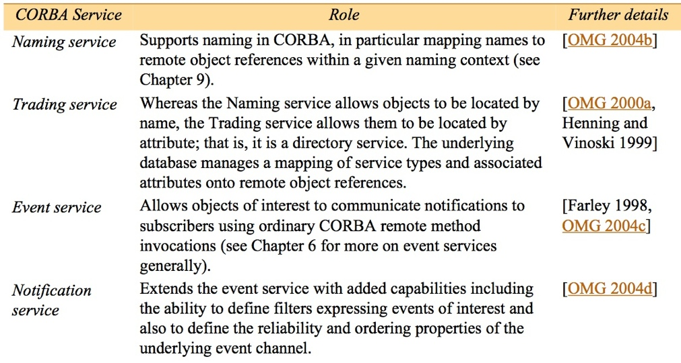
Figure 8.6
CORBA Services (1)
this figure continues on the next slide
Instructor’s Guide for Coulouris, Dollimore, Kindberg and Blair, Distributed Systems: Concepts and Design Edn. 5
© Pearson Education 2012

Slide 9
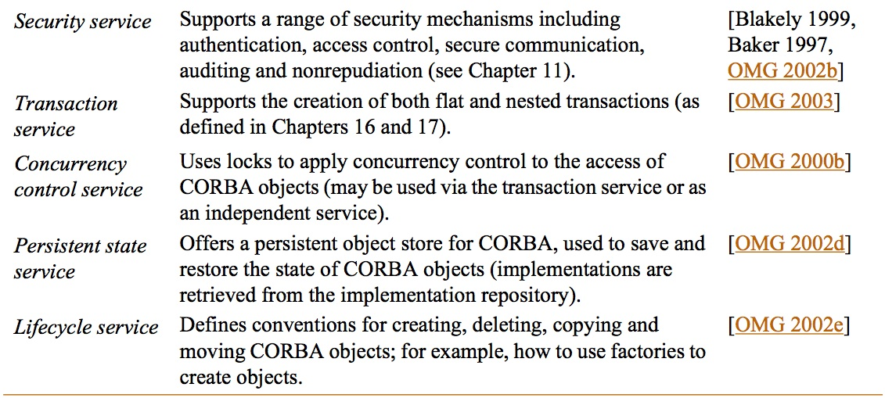
Figure 8.6
CORBA Services (continued)
Instructor’s Guide for Coulouris, Dollimore, Kindberg and Blair, Distributed Systems: Concepts and Design Edn. 5
© Pearson Education 2012

Slide 10
Figure 8.7
Java interfaces generated by idlj from CORBA interface ShapeList
public interface ShapeListOperations {
Shape newShape(GraphicalObject g) throws ShapeListPackage.FullException;
Shape[] allShapes();
int getVersion();
}
public interface ShapeList extends ShapeListOperations, org.omg.CORBA.Object,
org.omg.CORBA.portable.IDLEntity { }
Instructor’s Guide for Coulouris, Dollimore, Kindberg and Blair, Distributed Systems: Concepts and Design Edn. 5
© Pearson Education 2012

Slide 11
Figure 8.8
ShapeListServant class of the Java server program for CORBA interface ShapeList
import org.omg.CORBA.*;
import org.omg.PortableServer.POA;
class ShapeListServant extends ShapeListPOA {
private POA theRootpoa;
private Shape theList[];
private int version;
private static int n=0;
public ShapeListServant(POA rootpoa){
theRootpoa = rootpoa;
// initialize the other instance variables
}
// continued on the next slide
Instructor’s Guide for Coulouris, Dollimore, Kindberg and Blair, Distributed Systems: Concepts and Design Edn. 5
© Pearson Education 2012

Slide 12
Figure 8.8 continued
public Shape newShape(GraphicalObject g)
throws ShapeListPackage.FullException { 1
version++;
Shape s = null;
ShapeServant shapeRef = new ShapeServant( g, version);
try {
org.omg.CORBA.Object ref =
theRoopoa.servant_to_reference(shapeRef); 2
s = ShapeHelper.narrow(ref);
} catch (Exception e) {}
if(n >=100) throw new ShapeListPackage.FullException();
theList[n++] = s;
return s;
}
public Shape[] allShapes(){ ... }
public int getVersion() { ... }
}
Instructor’s Guide for Coulouris, Dollimore, Kindberg and Blair, Distributed Systems: Concepts and Design Edn. 5
© Pearson Education 2012

Slide 13
Figure 8.9
Java class ShapeListServer
import org.omg.CosNaming.*; import org.omg.CosNaming.NamingContextPackage.*;
import org.omg.CORBA.*; import org.omg.PortableServer.*;
public class ShapeListServer {
public static void main(String args[]) {
try{
ORB orb = ORB.init(args, null); 1
POA rootpoa = POAHelper.narrow(orb.resolve_initial_references("RootPOA"));2
rootpoa.the_POAManager().activate(); 3
ShapeListServant SLSRef = new ShapeListServant(rootpoa); 4
org.omg.CORBA.Object ref = rootpoa.servant_to_reference(SLSRef); 5
ShapeList SLRef = ShapeListHelper.narrow(ref);
org.omg.CORBA.Object objRef =orb.resolve_initial_references("NameService");
NamingContext ncRef = NamingContextHelper.narrow(objRef); 6
NameComponent nc = new NameComponent("ShapeList", ""); 7
NameComponent path[] = {nc}; 8
ncRef.rebind(path, SLRef); 9
orb.run(); 10
} catch (Exception e) { ... }
}}
Instructor’s Guide for Coulouris, Dollimore, Kindberg and Blair, Distributed Systems: Concepts and Design Edn. 5
© Pearson Education 2012

Slide 14
Figure 8.10
Java client program for CORBA interfaces Shape and ShapeList
import org.omg.CosNaming.*;
import org.omg.CosNaming.NamingContextPackage.*;
import org.omg.CORBA.*;
public class ShapeListClient{
public static void main(String args[]) {
try{
ORB orb = ORB.init(args, null); 1
org.omg.CORBA.Object objRef =
orb.resolve_initial_references("NameService");
NamingContext ncRef = NamingContextHelper.narrow(objRef);
NameComponent nc = new NameComponent("ShapeList", "");
NameComponent path [] = { nc };
ShapeList shapeListRef =
ShapeListHelper.narrow(ncRef.resolve(path)); 2
Shape[] sList = shapeListRef.allShapes(); 3
GraphicalObject g = sList[0].getAllState(); 4
} catch(org.omg.CORBA.SystemException e) {...}
}
Instructor’s Guide for Coulouris, Dollimore, Kindberg and Blair, Distributed Systems: Concepts and Design Edn. 5
© Pearson Education 2012

Slide 15
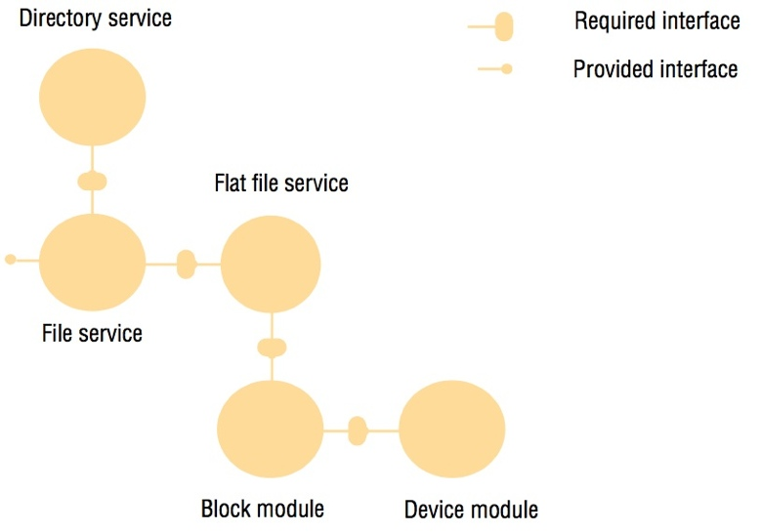
Figure 8.11
An example software architecture
Instructor’s Guide for Coulouris, Dollimore, Kindberg and Blair, Distributed Systems: Concepts and Design Edn. 5
© Pearson Education 2012

Slide 16
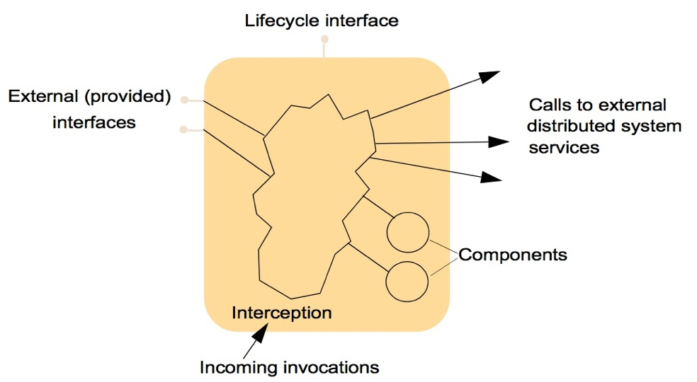
Figure 8.12
The structure of a container
Instructor’s Guide for Coulouris, Dollimore, Kindberg and Blair, Distributed Systems: Concepts and Design Edn. 5
© Pearson Education 2012

Slide 17
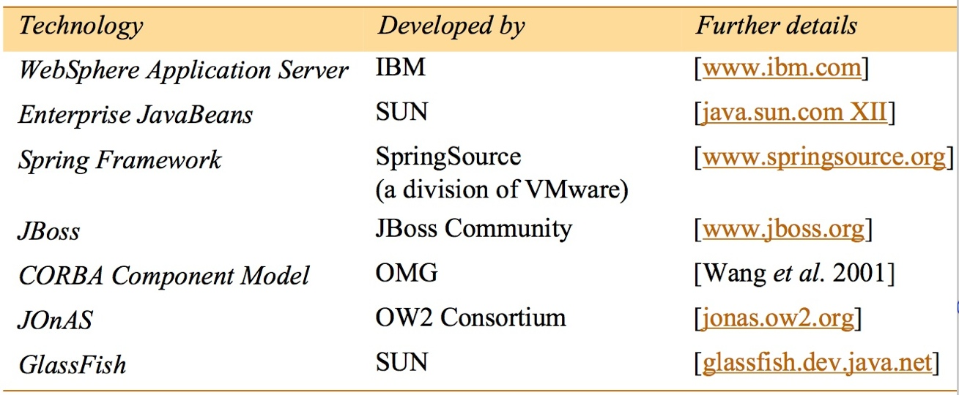
Figure 8.13
Application servers
Instructor’s Guide for Coulouris, Dollimore, Kindberg and Blair, Distributed Systems: Concepts and Design Edn. 5
© Pearson Education 2012

Slide 18
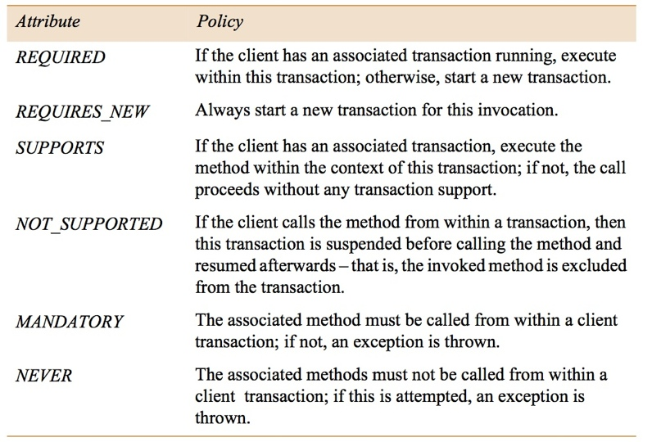
Figure 8.14
Transaction attributes in EJB.
Instructor’s Guide for Coulouris, Dollimore, Kindberg and Blair, Distributed Systems: Concepts and Design Edn. 5
© Pearson Education 2012

Slide 19
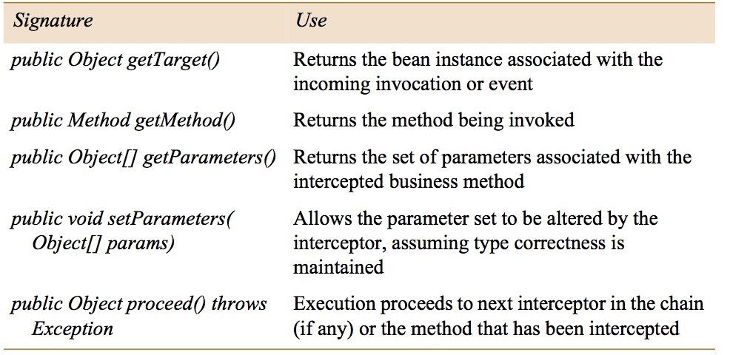
Figure 8.15
Invocation contexts in EJB
Instructor’s Guide for Coulouris, Dollimore, Kindberg and Blair, Distributed Systems: Concepts and Design Edn. 5
© Pearson Education 2012

Slide 20
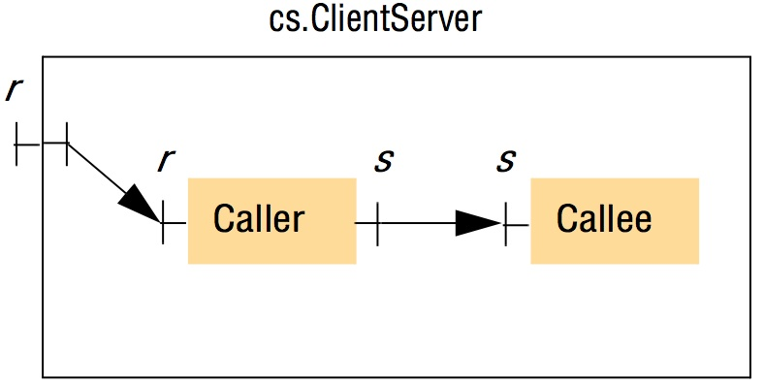
Figure 8.16
An example component configuration in Fractal
Instructor’s Guide for Coulouris, Dollimore, Kindberg and Blair, Distributed Systems: Concepts and Design Edn. 5
© Pearson Education 2012

Slide 21
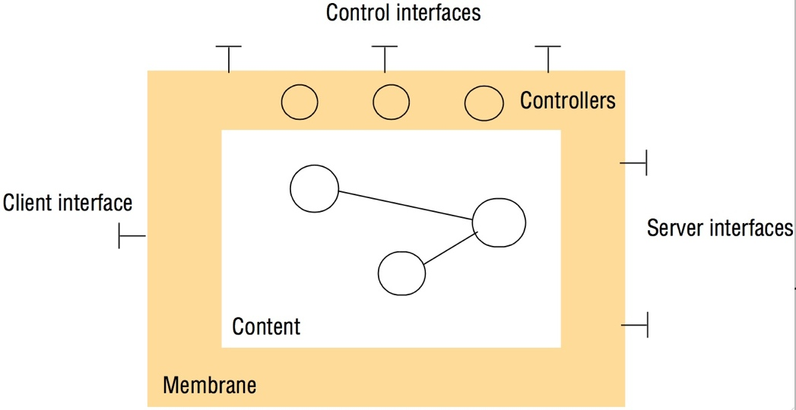
Figure 8.17
The structure of a Fractal component
Instructor’s Guide for Coulouris, Dollimore, Kindberg and Blair, Distributed Systems: Concepts and Design Edn. 5
© Pearson Education 2012

Slide 22
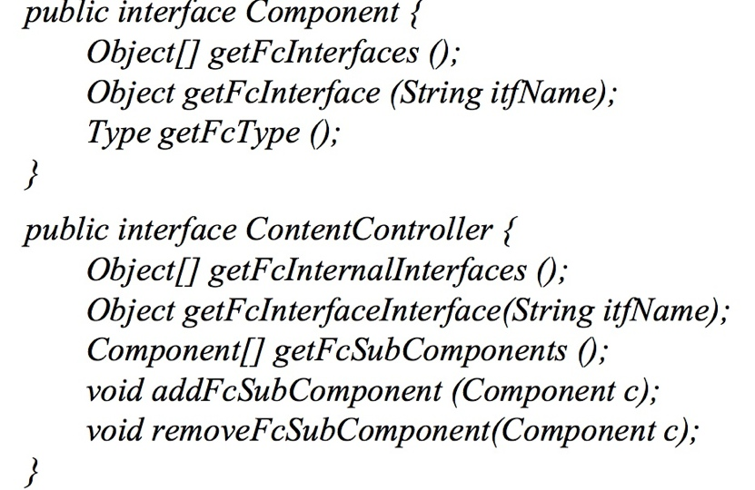
Figure 8.18
Component and ContentController Interfaces in Fractal
Instructor’s Guide for Coulouris, Dollimore, Kindberg and Blair, Distributed Systems: Concepts and Design Edn. 5
© Pearson Education 2012

